Slide 1
project to develop an 8-Puzzle game using the Unity engine and C# DIGITAL GAME DEVELOPMENT: INSTITUTO DE COMPUTAÇÃO - IC/UFF PÓS-GRADUAÇÃO EM COMPUTAÇÃO – PPGC UNIVERSIDADE FEDERAL FLUMINENSE
OWOOLA OLUWAGBEMILEKE BAMISE

Slide 2
Introduction
A Project to develop an 8 Puzzle Game Using the Unity Engine C#.
The Core focus is on implementing the Games logic and integrating pathfind the Puzzle.

Slide 3
Objectives
The projects details the representation of Puzzle States.
The construction of neighbour connections between states.
The Implementation of different pathfinding approaches.
Its also covers the technical aspects within Unity.
Including projects setup, UI Creation and utilizing C# Scripts to manage game functionality and solve the puzzle.

Slide 4
What is the 8-Puzzle Problem?
A sliding puzzle consisting of 8 numbered tiles and 1 empty space.
Move tiles to achieve the goal state and Solvable with different algorithms.
Ideal for demonstrating heuristic search.

Slide 5
Why A Algorithm?*
A* is a graph traversal and pathfinding algorithm. Combines: g(n):
Cost from start to current node. h(n): Heuristic estimate to the goal.
Guarantees optimal solution if heuristic is admissible.

Slide 6
Heuristic Used Manhattan Distance
Sum of the distances of each tile from its goal position. Admissible and consistent.
Why it’s Effective:
Simple to compute. Guides A* efficiently towards solution.

Slide 7
System Architecture Unity
GameObject represents each tile.
CORE SCRIPTS:
Node: Represents puzzle state.
AStarSolver: Implements A* algorithm.
PuzzleManager: Manages puzzle state and UI.
Flow: User scrambles puzzle. Press “Solve” -> A* finds solution path.
Puzzle animates moves step by step.

Slide 8
A Algorithm Implementation*
Open and Closed lists to track nodes. f(n) = g(n) + h(n)For each step:
Select node with lowest f(n).
Expand possible moves.
Check for goal state.
Stores solution path for animation.

Slide 9
Unity Visual Implementation
Puzzle grid displayed using UI buttons or sprites.
User interface includes:
Scramble button.
Solve button.
Puzzle visually animates solving process.

Slide 10
Demonstration
Initial scrambled puzzle.
A* solving the puzzle step-by-step.
Final solved state.
Screenshot and video thumbnail.

Slide 11
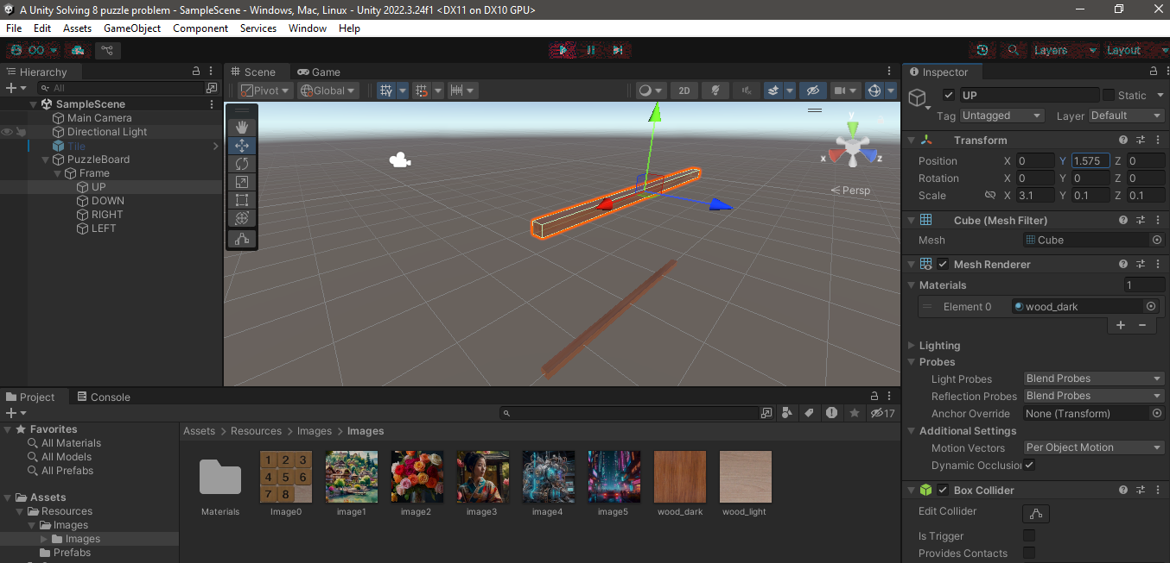
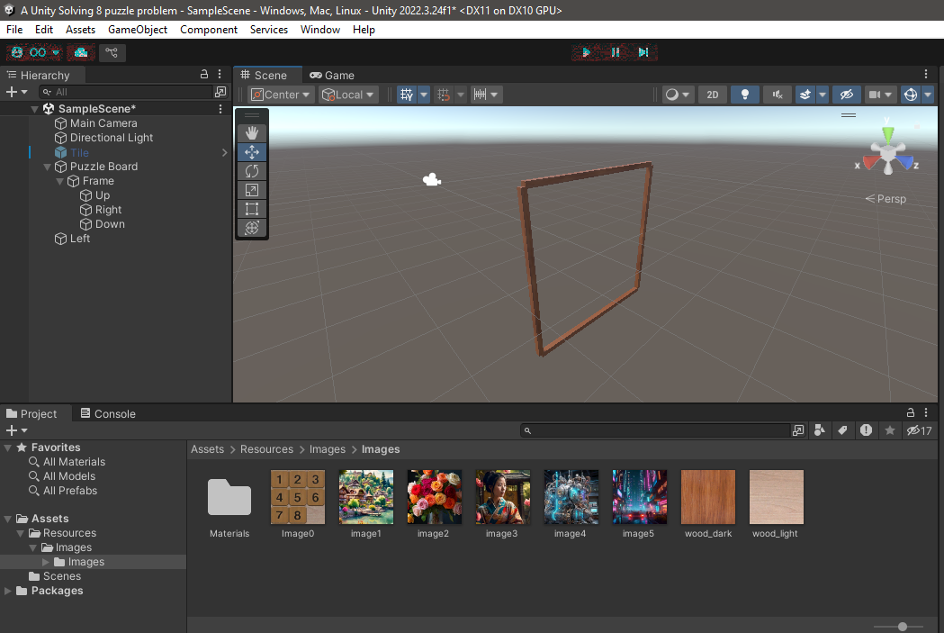
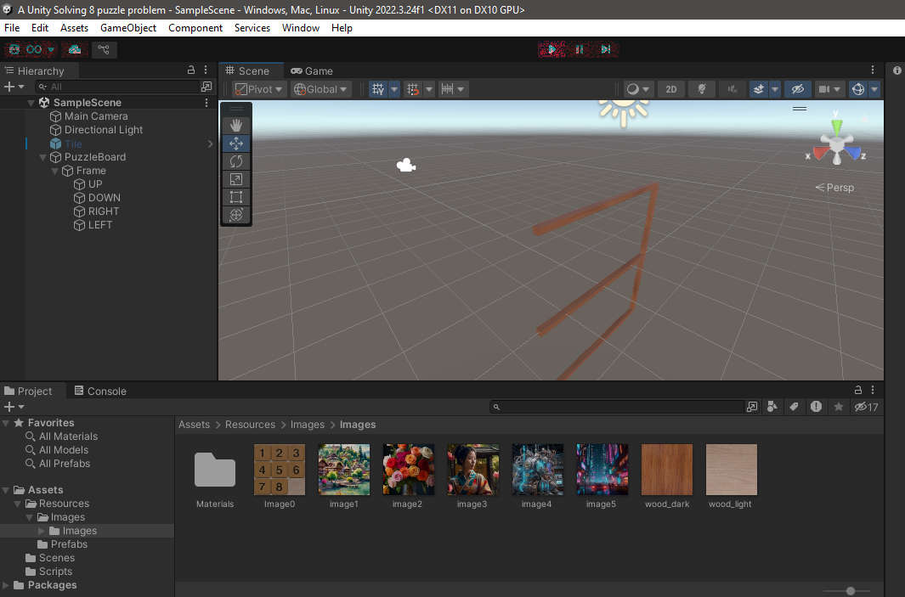
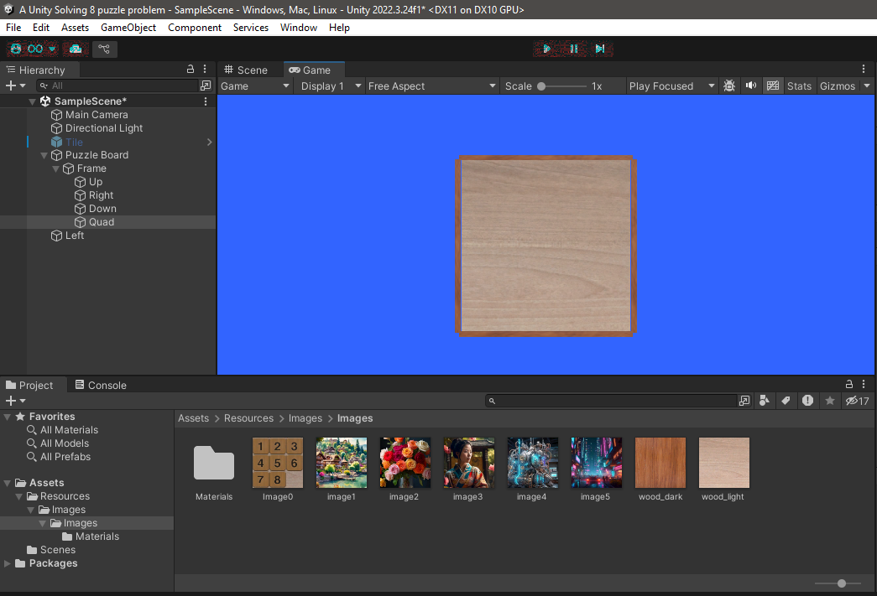
Puzzle interface and image random display

Slide 12
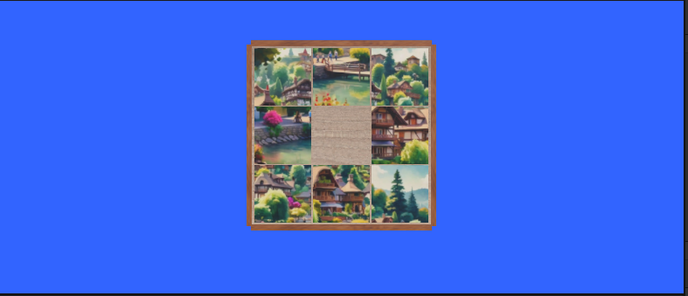
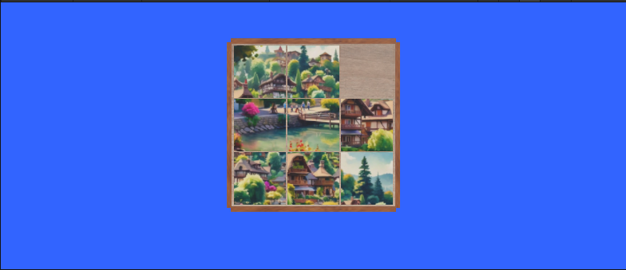
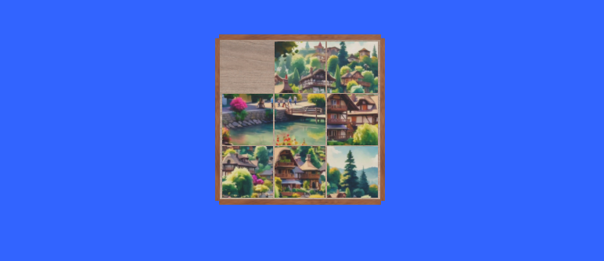
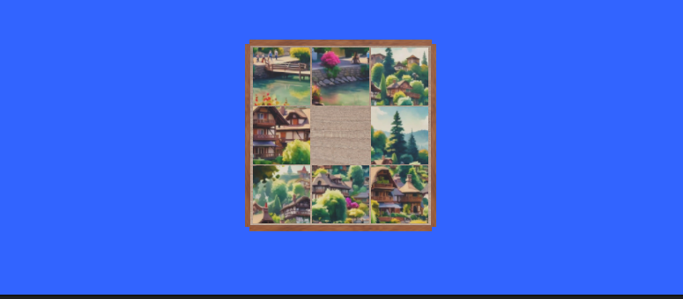
Puzzle interface and image random display

Slide 13
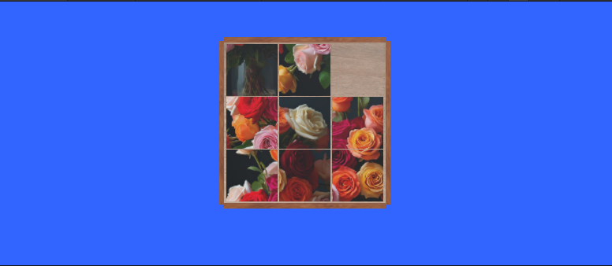
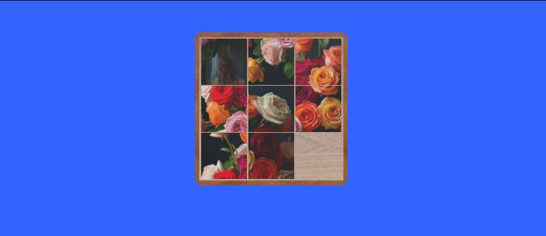
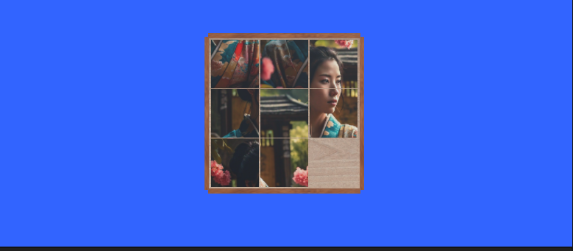
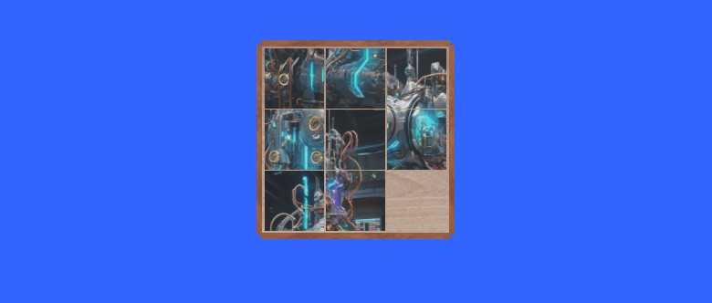
Puzzle interface and image random display

Slide 14
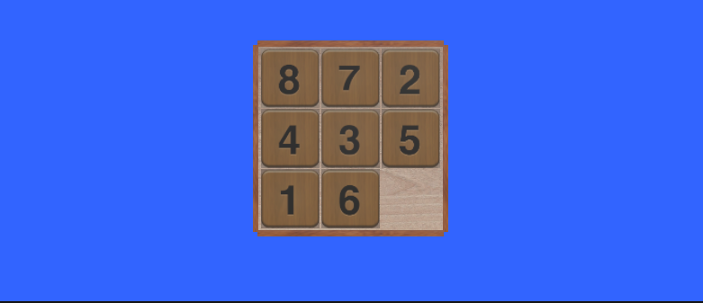
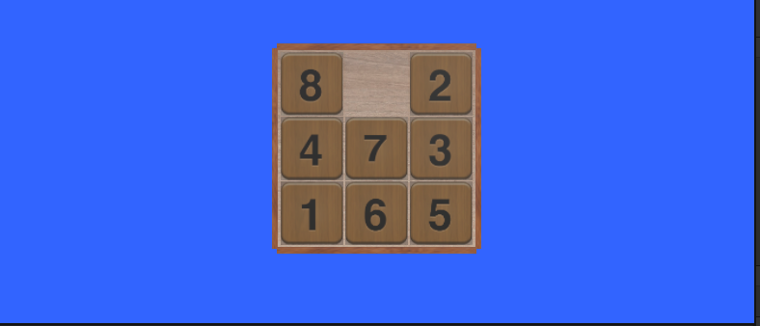
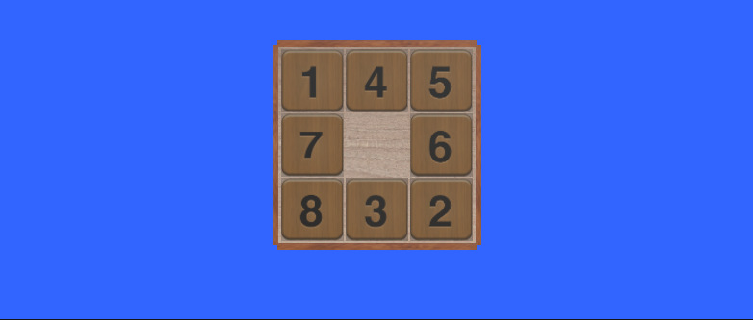
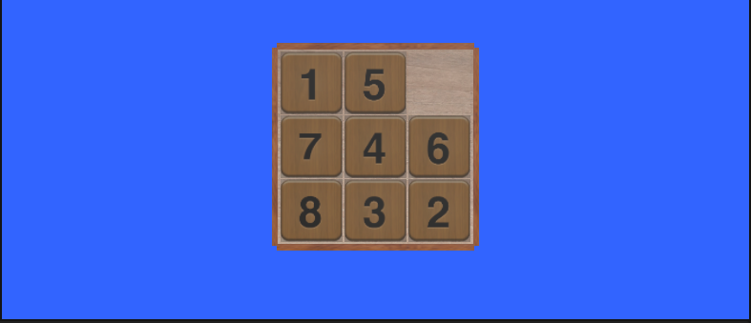
Puzzle interface and image random display

Slide 15
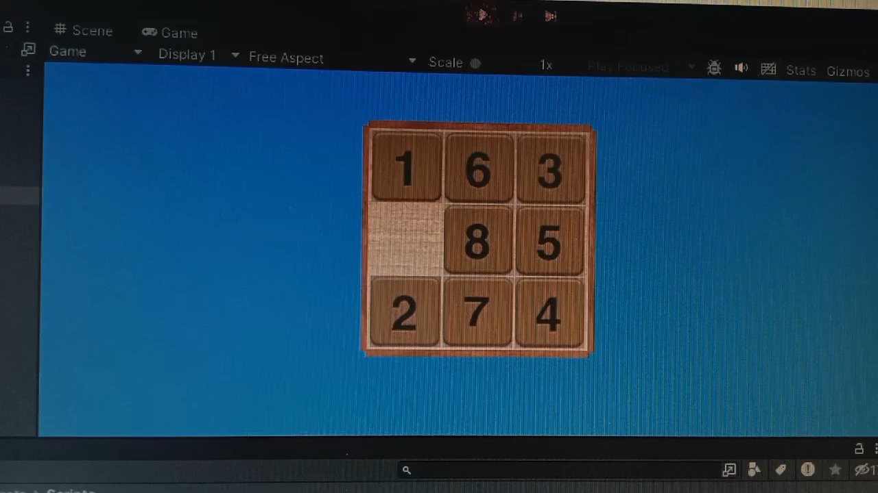
Puzzle interface VIDEO display

Slide 16
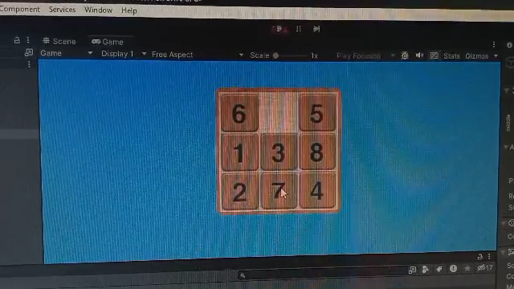
Puzzle interface VIDEO display

Slide 17
Challenges
Faced Managing performance with larger search trees.
Visual synchronization of algorithm steps with Unity animations.
Ensuring heuristic correctness.

Slide 18
CONCLUSIONS
Effectively solves the 8-puzzle problem optimally.
Unity is a flexible platform for visualizing AI algorithms.
Practical understanding of heuristic search and pathfinding.

